Slide 1
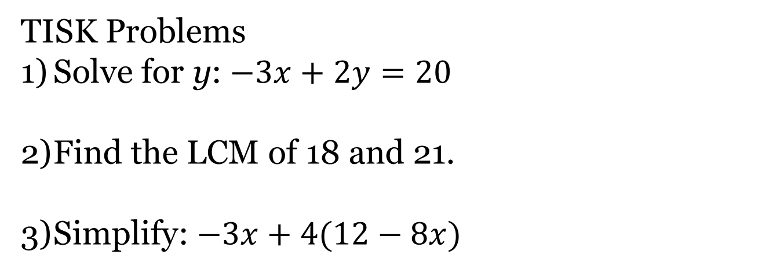
Wednesday, December 5, 2012
Agenda:
TISK Problems & No MM
Homework Check
Lesson 11-3: Slope-Intercept Form
Homework: Slope-Intercept Form worksheet
TISK Problems
Solve for y: $−3x+2y=20$
Find the LCM of 18 and 21.
Simplify: $−3x+4(12−8x)$

Slide 2
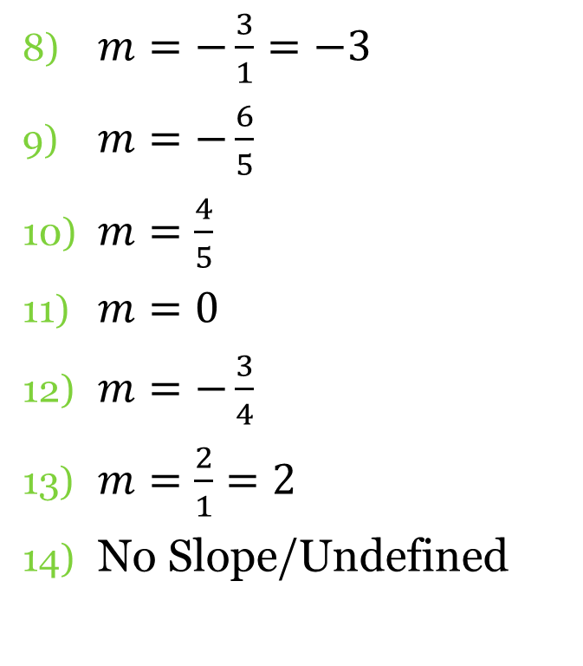
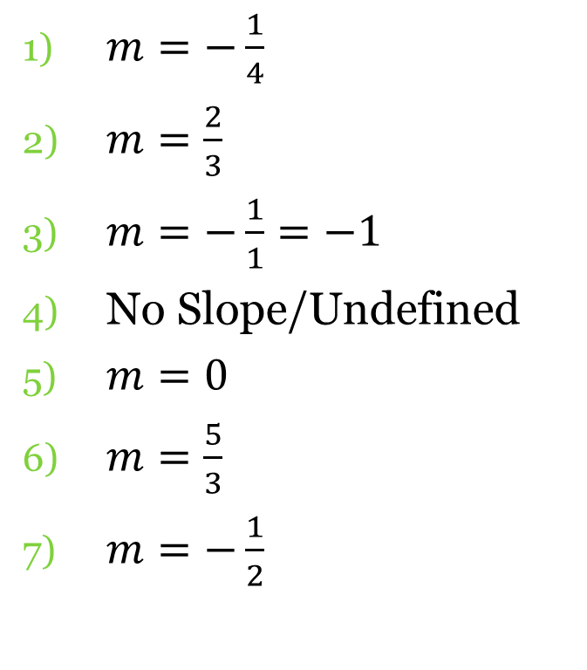
Homework Check
$m=−\frac{1}{4}$
$m=\frac{2}{3}$
$m=−\frac{1}{1}=−1$
No Slope/Undefined
$m=0$
$m=\frac{5}{3}$
$m=−\frac{1}{2}$
$m=−\frac{3}{1}=−3$
$m=−\frac{6}{5}$
$m=\frac{4}{5}$
$m=0$
$m=−\frac{3}{4}$
$m=\frac{2}{1}=2$
No Slope/Undefined

Slide 3
§11-3 Slope-Intercept Form
When an equation is written in slope-intercept form it always looks like this:
$$y=mx+b$$
Where (x, y) are the coordinates of any point on the line,
m stands for slope (how you move),
and b stands for the y-intercept (where you begin on the y-axis).

Slide 4

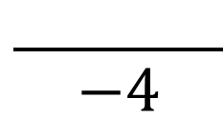

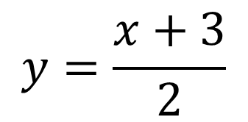





Write the equation in slope-intercept form.
$$y=mx+b$$
$$y=\frac{x+3}{2}$$
$$2x−4y=16$$
$$−2x$$
$$−2x$$
Distribute!
$$−4y=−2x+16$$
$$y=mx+b$$
$$\frac{ }{−4}$$
$$\frac{ }{−4}$$
$$y=\frac{1}{2}x+\frac{3}{2}$$
$$y=\frac{1}{2}x+\frac{3}{2}$$
$$y=\frac{1}{2}x+(−4)$$
$$y=\frac{1}{2}x+(−4)$$
$$\frac{1}{2}$$
$$\frac{1}{2}$$
So what is the slope of this equation?
So what is the slope of this equation?
$$\frac{3}{2}$$
And what is the y-intercept of this equation?
And what is the y-intercept of this equation?
$$−4$$

Slide 5
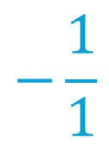
Write the equation in slope-intercept form.
$$y=−x+2$$
$$y=−4$$
$$y=mx+b$$
$$y=mx+b$$
$$y=−1x+2$$
$$y=−1x+2$$
$$y=0x+(−4)$$
$$y=0x+(−4)$$
$$−\frac{1}{1}$$
So what is the slope of this equation?
So what is the slope of this equation?
$$0$$
And what is the y-intercept of this equation?
$$2$$
And what is the y-intercept of this equation?
$$−4$$

Slide 6
Graph the equation.
$$3x+y=2$$
y
$$−3x$$
$$−3x$$
$$y=−3x+2$$
$$y=−3x+2$$
x
1) Write in slope-intercept form.
2) Place a point on the y-intercept.
3) Use the slope to move to the next point.
4) Connect the dots!

Slide 7

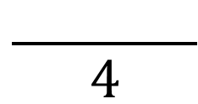


Graph the equation.
y
$$3x+4y=8$$
$$−3x$$
$$−3x$$
$$4y=−3x+8$$
$$\frac{ }{4}$$
$$\frac{ }{4}$$
x
$$y=−\frac{3}{4}x+2$$
$$y=−\frac{3}{4}x+2$$

